Slide 1
Python Sequences
Lists

Slide 2
Topics Covered
What is Python Sequences?
List With It’s CRUD Operation.
Indexing in Lists
Iterating Though Lists
Merging The Lists
Access and Slicing in Lists
Built-in Functions for Lists in Python

Slide 3
Python Sequences
Sequences are containers with items stored in a deterministic ordering. Each sequence data type comes with its unique capabilities.
Types of Python Sequences.
1. List
2. Tuples
3. Dictionaries
4. Sets

Slide 4
Lists in Python
a list is a built-in dynamic sized array (automatically grows and shrinks). We can store all types of items (including another list) in a list.
A list may contain mixed type of items, this is possible because a list mainly stores references at contiguous locations and actual items maybe stored at different locations.
Lists
can contain duplicate values.
are mutable.
are ordered.
can be access using index, which is starting from 0.

Slide 5
List Example:
a = [10, 20, "GfG", 40, True]
print(a)
# Accessing elements using indexing
print(a[0]) # 10
print(a[1]) # 20
print(a[2]) # "GfG"
print(a[3]) # 40
print(a[4]) # True
# Checking types of elements
print(type(a[2])) # str
print(type(a[4])) # bool

Slide 6
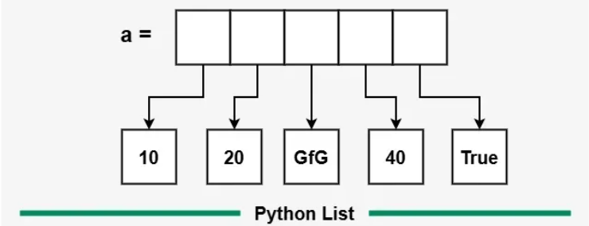
Memory Allocation and Explanation
Note : Lists Store References, Not Values!
Each element in a list is not stored directly inside the list structure.
Instead, the list stores references (pointers) to the actual objects in memory.

Slide 7
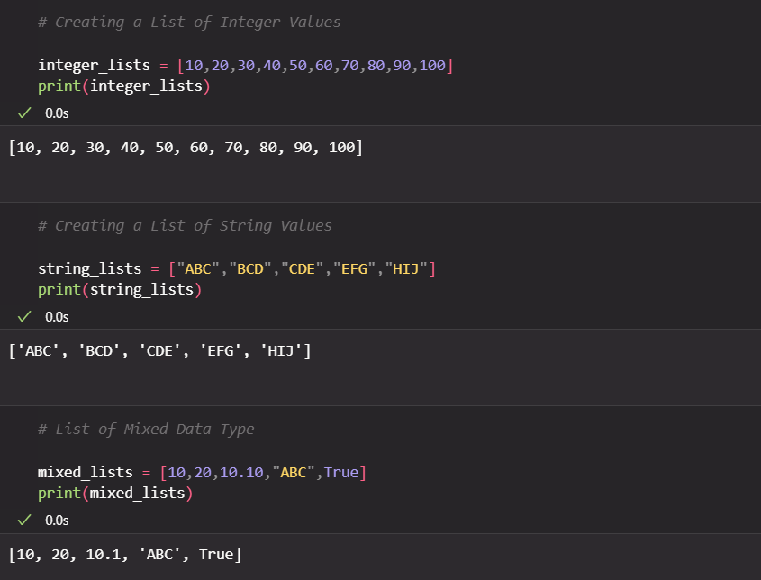
Creating a List

Slide 8
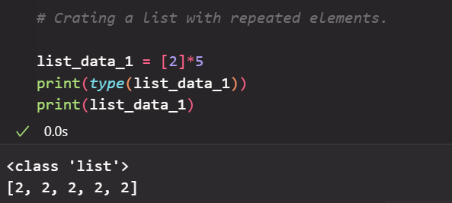
creating a list using list() constructor
# Using list Constructor
# From tuple
list_constructor = list((10,20,30,40,50))
print(type(list_constructor))
Creating a list using Repeated elements.

Slide 9
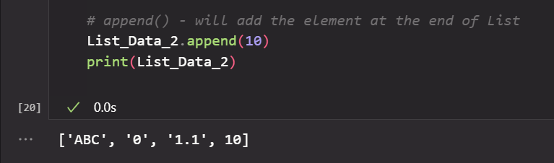
Adding Elelments into Lists
append(): Adds an element at the end of the list.
extend(): Adds multiple elements to the end of the list.
insert(): Adds an element at a specific position.
Example :

Slide 10
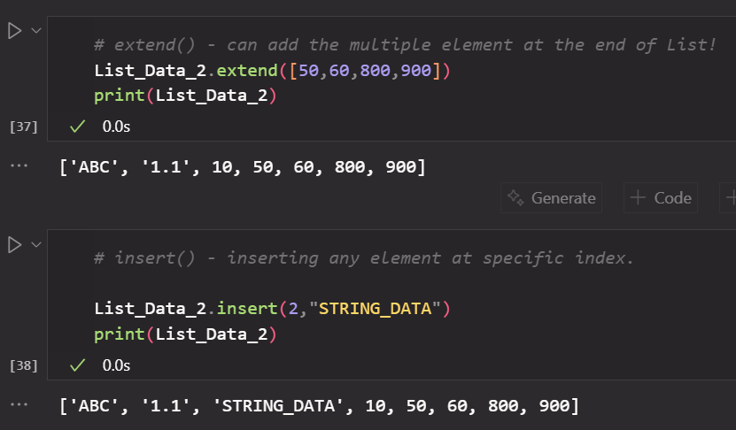
Adding Elelments into Lists

Slide 11
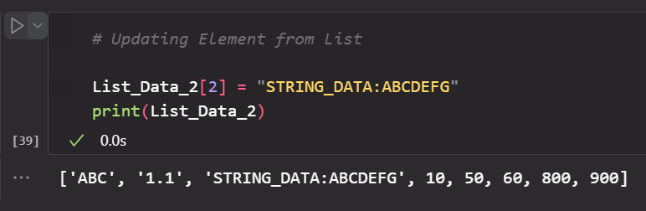
Updating Elements into Lists
Using Index Reference We can Update The Element which in the list.

Slide 12
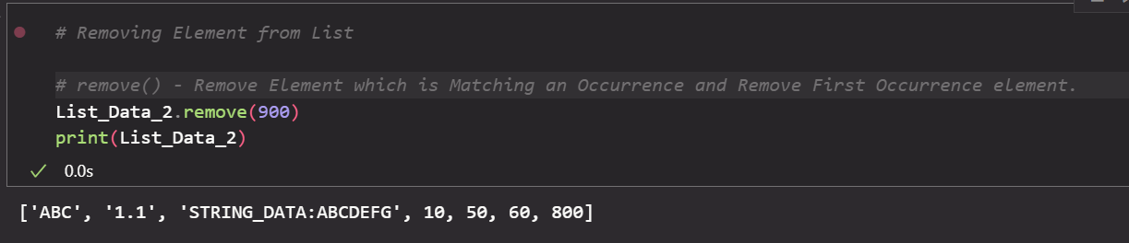
Removing Elements from Lists
remove(): Removes the first occurrence of an element.
pop(): Removes the element at a specific index or the last element if no index is specified.
del statement: Deletes an element at a specified index.

Slide 13
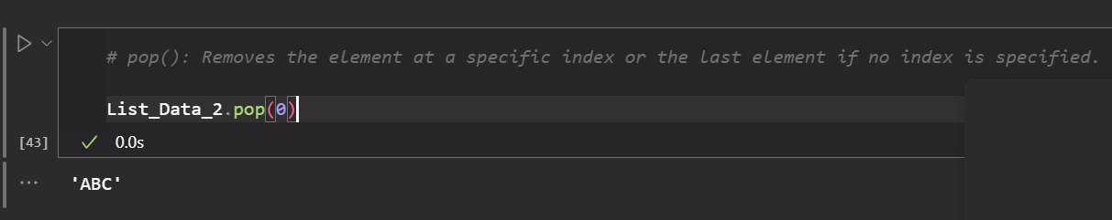
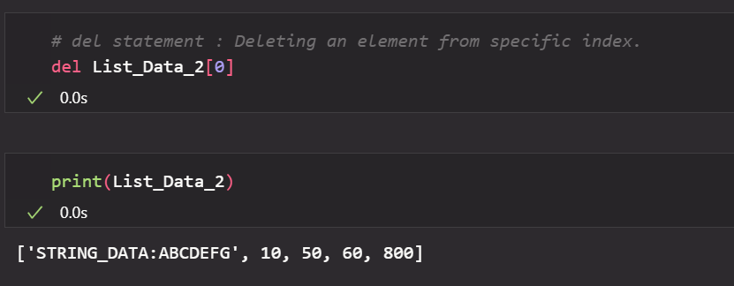
Removing Elements from Lists

Slide 14
Iteration over Lists
it can done using few ways :
1. using simple for loops
2. range() in for loops
3. using enumarations.
4. while loop
5. List Comprehension
6. using map()
7. Iterating Backwords
8. Using zip()
9. using iter() and next()
10. Using enumerate() with Step

Slide 15
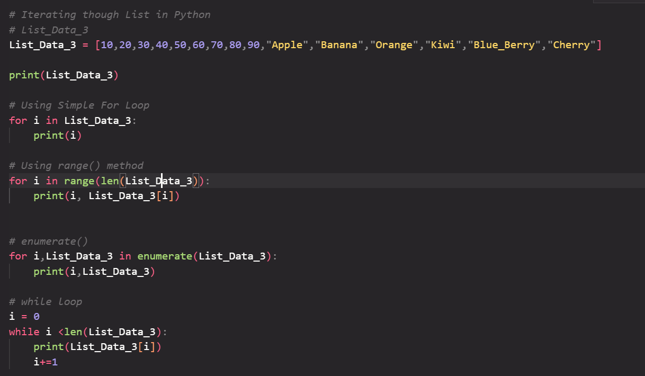
Example: List Iteration

Slide 16
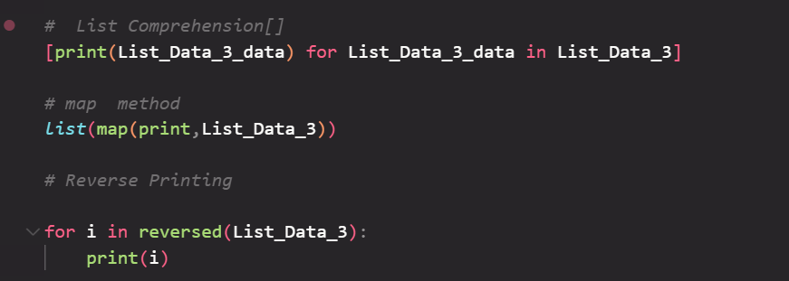
Example: List Iterator

Slide 17
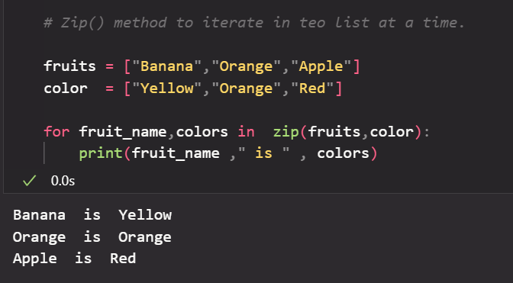
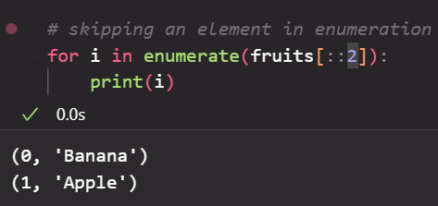
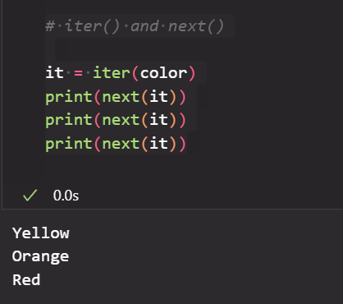
Example : List Iterator

Slide 18
Merging The Lists
It can done using few ways:
1. ‘+’ Operator
2. += Operator
3. .extend() Method
4. Unpacking with * (python 3.5+)
5. List Comprehension
6. itechain.tools()
Let’s See the examples...

Slide 19
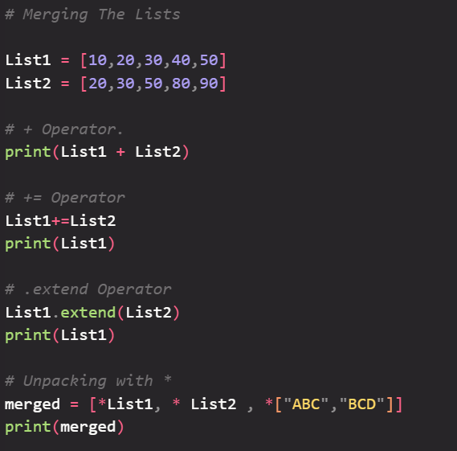
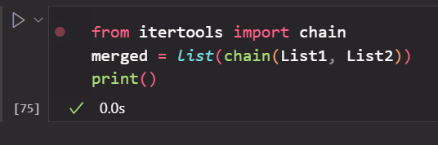
Example : List Merging

Slide 20
Example : List Merging
merged = [x for x in List1 + List2 if x % 2 == 0]
print(merged)
this is the list comprehension with filter condition example which will help in data filteration in python.
pandas is also having built in function to filter the data.

Slide 21
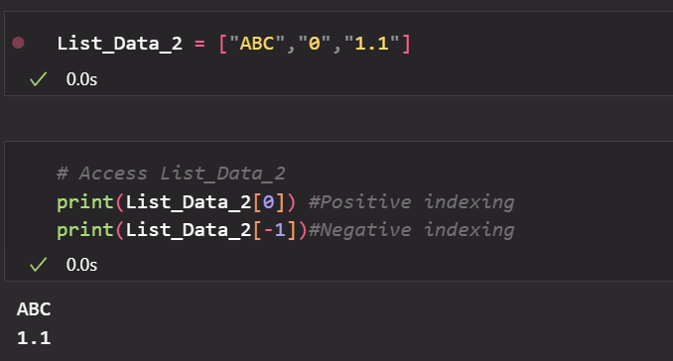
Accessing List Elements (indexing)
Elements in a list can be accessed using indexing.
Python indexes start at 0, so a[0] will access the first element, while negative indexing allows us to access elements from the end of the list.
Like index -1 represents the last elements of list.

Slide 22
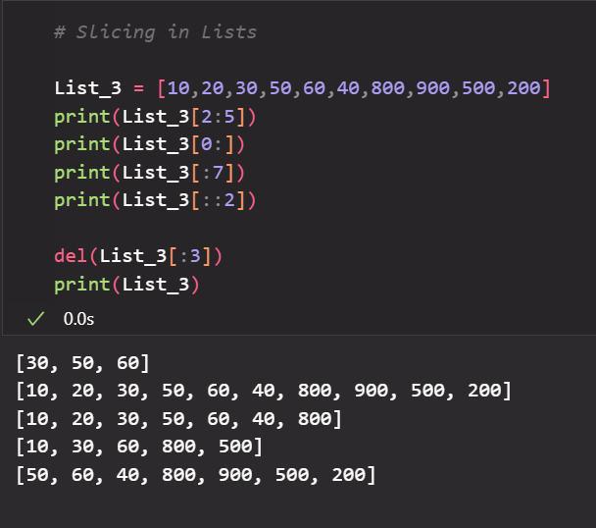
Slicing the Lists

Slide 23
Built in Function for Lists in Python
.index(x)
.count(x)
.sort()
.sort(reverse = True)
.reverse()
.copy
len(List_name)
min(List_name) and max(List_name)
sum(List_name)

Slide 24
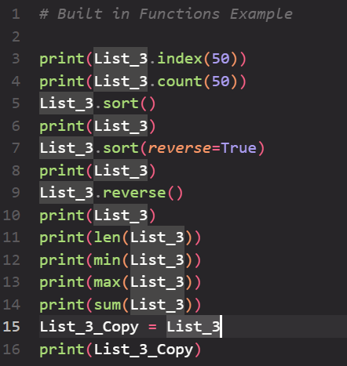
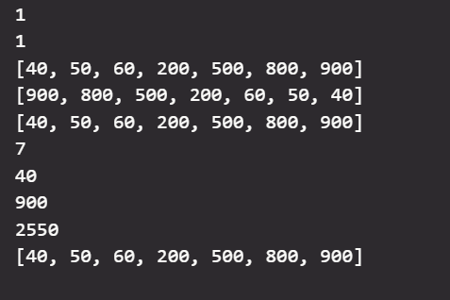
Example

Slide 25
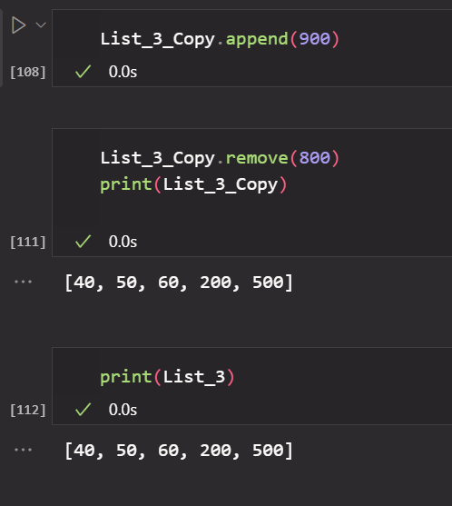
.copy()
Key Difference from Deep Copy
Shallow copy: Copies only the first layer, inner objects are shared.
Deep copy: Recursively copies everything, so changes in one list don’t affect the other.

Slide 26
Multi-Dimensional Lists
A multi-dimensional list is simply a list of lists (or a list of lists of lists… you get the idea).
2D list → matrix-like (rows × columns)
3D list → cube-like (rows × columns × depth)
matrix = [
[1, 2, 3], # Row 0
[4, 5, 6], # Row 1
[7, 8, 9] # Row 2
]

Slide 27
Accessing That
for row in matrix:
for value in row:
print(value, end=" ")
3D Lists Example :
cube = [[[0 for k in range(2)] for j in range(3)] for i in range(4)]

Slide 28
References
https://pythongeeks.org/python-sequences-types-examples/
https://www.geeksforgeeks.org/python/python-lists/
https://chatgpt.com

